Slide 1
Arduino & its Programming Concepts
Overview of Arduino
Arduino is an open-source electronics platform based on easy-to-use hardware and
software. Arduino boards are able to read inputs - light on a sensor, a finger on a button, or a Twitter message - and turn it into an output - activating a motor, turning on an LED, publishing something online. You can tell your board what to do by sending a set of instructions to the microcontroller on the board. To do so you use the Arduino programming language (based on Wiring), and the Arduino Software (IDE), based on Processing.
Over the years Arduino has been the brain of thousands of projects, from everyday objects to
complex scientific instruments. A worldwide community of makers - students, hobbyists, artists, programmers, and professionals - has gathered around this open-source platform, their contributions have added up to an incredible amount of accessible knowledge that can be of great help to novices and experts alike.
Arduino was born at the Ivrea Interaction Design Institute as an easy tool for fast prototyping,
aimed at students without a background in electronics and programming. As soon as it reached a wider community, the Arduino board started changing to adapt to new needs and challenges, differentiating its offer from simple 8-bit boards to products for IoT applications, wearable, 3D printing, and embedded environments.
Why Arduino?
Thanks to its simple and accessible user experience, Arduino has been used in thousands of
different projects and applications. The Arduino software is easy-to-use for beginners, yet
flexible enough for advanced users. It runs on Mac, Windows, and Linux. Teachers and students use it to build low cost scientific instruments, to prove chemistry and physics principles, or to get started with programming and robotics. Designers and architects build interactive prototypes, musicians and artists use it for installations and to experiment with new musical instruments. Makers, of course, use it to build many of the projects exhibited at the Maker Faire, for example. Arduino is a key tool to learn new things. Anyone - children, hobbyists, artists, programmers -

Slide 2
can start tinkering just following the step-by-step instructions of a kit, or sharing ideas online with other members of the Arduino community.
There are many other microcontrollers and microcontroller platforms available for physical computing. Parallax Basic Stamp, Netmedia's BX-24, Phidgets, MIT's Handyboard, and many others offer similar functionality. All of these tools take the messy details of microcontroller programming and wrap it up in an easy-to-use package. Arduino also simplifies the process of working with microcontrollers, but it offers some advantage for teachers, students, and interested amateurs over other systems:
Inexpensive - Arduino boards are relatively inexpensive compared to other microcontroller platforms. The least expensive version of the Arduino module can be assembled by hand, and even the pre-assembled Arduino modules cost less than \$50
Cross-platform - The Arduino Software (IDE) runs on Windows, Macintosh OSX, and Linux operating systems. Most microcontroller systems are limited to Windows.
Simple, clear programming environment - The Arduino Software (IDE) is easy-to-use
for beginners, yet flexible enough for advanced users to take advantage of as well. For teachers, it's conveniently based on the Processing programming environment, so students learning to program in that environment will be familiar with how the Arduino IDE works.
Open source and extensible software - The Arduino software is published as open source tools, available for extension by experienced programmers. The language can be expanded through C++ libraries, and people wanting to understand the technical details can make the leap from Arduino to the AVR C programming language on which it's based. Similarly, you can add AVR-C code directly into your Arduino programs if you want to.
Open source and extensible hardware - The plans of the Arduino boards are published under a Creative Commons license, so experienced circuit designers can make their own version of the module, extending it and improving it. Even relatively inexperienced users can build the breadboard version of the module in order to understand how it works and save money.

Slide 3
Arduino Board Description
Arduino is an easy-to-use open platform to create electronics projects. Arduino boards play a vital role in creating different projects. It makes electronics accessible to non-engineers, hobbyists, etc.
The various components present on the Arduino boards are Microcontroller, Digital
Input/output pins, USB Interface and Connector, Analog Pins, Reset Button, Power button, LED's, Crystal Oscillator, and Voltage Regulator. Some components may differ depending on the type of board.
The most standard and popular board used over time is Arduino UNO. The ATmega328
Microcontroller present on the UNO board makes it rather powerful than other boards. There are various types of Arduino boards used for different purposes and projects. The Arduino Boards are organized using the Arduino (IDE), which can run on various platforms. Here, IDE stands for Integrated Development Environment.
List of available boards in Arduino software
The list of boards that we can see in the Arduino software is shown below:

Slide 4
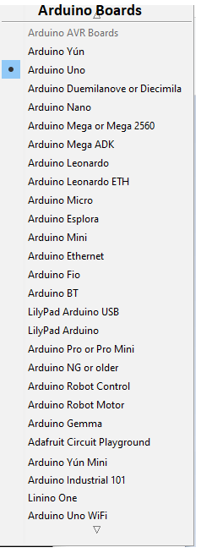
Here, the dot represents the select Arduino board in the Arduino IDE.
Arduino UNO
The Arduino UNO is a standard board of Arduino. Here UNO means 'one' in Italian. It was
named as UNO to label the first release of Arduino Software. It was also the first USB board released by Arduino. It is considered as the powerful board used in various projects. Arduino.cc developed the Arduino UNO board.

Slide 5
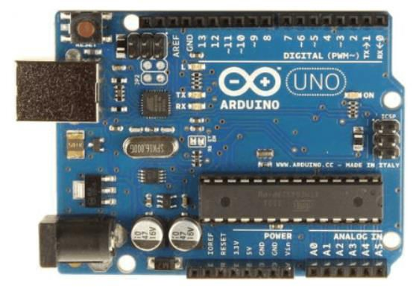
Arduino UNO is based on an ATmega328P microcontroller. It is easy to use compared to other boards, such as the Arduino Mega board, etc. The board consists of digital and analog Input/Output pins (I/O), shields, and other circuits.
The Arduino UNO includes 6 analog pin inputs, 14 digital pins, a USB connector, a power jack,
and an ICSP (In-Circuit Serial Programming) header. It is programmed based on IDE, which stands for Integrated Development Environment. It can run on both online and offline platforms. The IDE is common to all available boards of Arduino.
The Arduino board is shown below:
The components of Arduino UNO board are shown below:

Slide 6
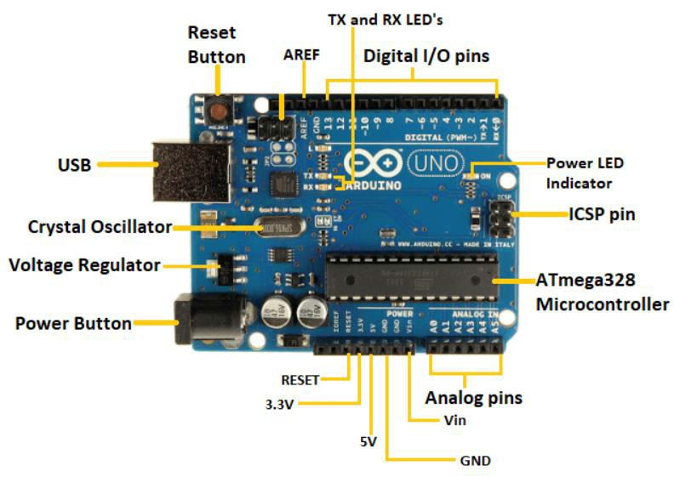
Let's discuss each component in detail.
ATmega328 Microcontroller- It is a single chip Microcontroller of the ATmel family. The processor code inside it is of 8-bit. It combines Memory (SRAM, EEPROM, and
Flash), Analog to Digital Converter, SPI serial ports, I/O lines, registers, timer, external and internal interrupts, and oscillator.
ICSP pin - The In-Circuit Serial Programming pin allows the user to program using the
firmware of the Arduino board.
Power LED Indicator- The ON status of LED shows the power is activated. When the power is OFF, the LED will not light up.
Digital I/O pins- The digital pins have the value HIGH or LOW. The pins numbered
from D0 to D13 are digital pins.
TX and RX LED's- The successful flow of data is represented by the lighting of these LED's.
AREF- The Analog Reference (AREF) pin is used to feed a reference voltage to the
Arduino UNO board from the external power supply.
Reset button- It is used to add a Reset button to the connection.

Slide 7
USB- It allows the board to connect to the computer. It is essential for the programming of the Arduino UNO board.
Crystal Oscillator- The Crystal oscillator has a frequency of 16MHz, which makes the Arduino UNO a powerful board.
Voltage Regulator- The voltage regulator converts the input voltage to 5V.
GND- Ground pins. The ground pin acts as a pin with zero voltage.
Vin- It is the input voltage.
Analog Pins- The pins numbered from A0 to A5 are analog pins. The function of Analog
pins is to read the analog sensor used in the connection. It can also act as GPIO (General Purpose Input Output) pins.
Why is Arduino recommended over other boards for beginners?
The USB port in the Arduino board is used to connect the board to the computer using the USB
cable. The cable acts as a serial port and as the power supply to interface the board. Such dual functioning makes it unique to recommend and easy to use for beginners.
Memory
The memory structure is shown in the below image:

Slide 8
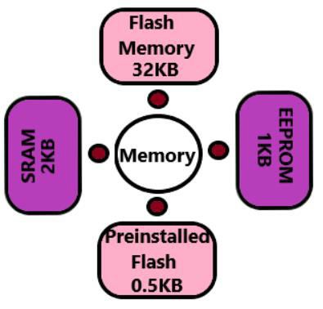
The preinstalled flash has a bootloader, which takes the memory of 0.5 Kb. Here, SRAM stands for Static Random Access Memory, and EEPROM stands for Electrically Erasable Programmable Read-Only Memory.
Technical Specifications of Arduino UNO
The technical specifications of the Arduino UNO are listed below:
There are 20 Input/Output pins present on the Arduino UNO board. These 20 pis include 6 PWM pins, 6 analog pins, and 8 digital I/O pins.
The PWM pins are Pulse Width Modulation capable pins.
The crystal oscillator present in Arduino UNO comes with a frequency of 16MHz.
It also has a Arduino integrated WiFi module. Such Arduino UNO board is based on the Integrated WiFi ESP8266 Module and ATmega328P microcontroller.
The input voltage of the UNO board varies from 7V to 20V.
Arduino UNO automatically draws power from the external power supply. It can also draw power from the USB.

Slide 9
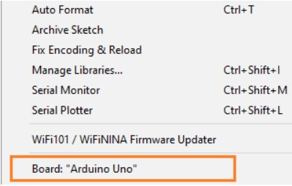
How to get started with Arduino UNO?
We can program the Arduino UNO using the Arduino IDE. The Arduino IDE is the Integral
Development program, which is common to all the boards.
We can also use Arduino Web Editor, which allows us to upload sketches and write the code
from our web browser (Google Chrome recommended) to any Arduino Board. It is an online platform.
The USB connection is essential to connect the computer with the board. After the connection, the PWR pins will light in green. It is a green power LED.
The steps to get started with Arduino UNO are listed below:
o Install the drivers of the board.
As soon we connect the board to the computer, Windows from XP to 10 will automatically install the board drivers.
But, if you have expanded or downloaded the zip package, follow the below steps:
Click on Start -> Control Panel -> System and Security.
Click on System -> Device Manager -> Ports (COM &LPT) -> Arduino UNO (COMxx). If the COM &LPT is absent, look Other Devices -> Unknown Device.
Right-click to Arduino UNO (COmxx) -> Update Driver Software -> Browse my computer for driver software.
Select the file "inf" to navigate else, select "ArduinoUNO.inf".
Installation Finished.
Open the code or sketch written in the Arduino software.
Select the type of board. Click on 'Tools' and select Board, as shown below:
Select the port. Click on the Tools -> Port (select the port). The port likely will be COM3 or higher. For example, COM6, etc. The COM1 and COM2 ports will not appear, because these two ports are reserved for the hardware serial ports.

Slide 10

Now, upload and run the written code or sketch.
To upload and run, click on the button present on the top panel of the Arduino display, as shown below:
Within the few seconds after the compile and run of code or sketch, the RX and TX light present on the Arduino board will flash.
The 'Done Uploading' message will appear after the code is successfully uploaded. The message will be visible in the status bar.

